Slide 1
Lecture 1: introduction
CSC5991: Introduction to LLMs

Slide 2
Welcome to the Course
Background.
Overview of the course objectives and structure.
Importance of LLMs in modern AI.
Brief introduction to the topics we will cover.
Q&A.

Slide 3
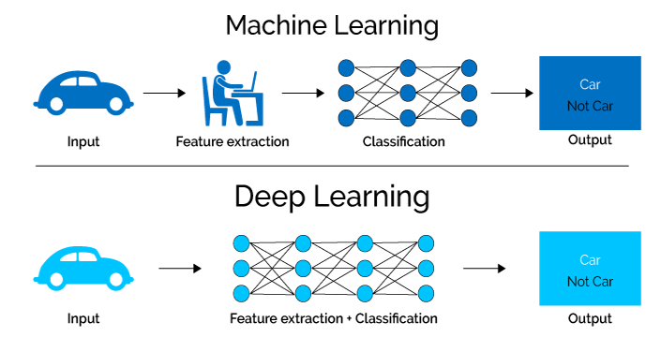
Background
Machine Learning
Deep Learning

Slide 4
History of Deep Learning
Traditional ML/DL (Before 2018)
Design specialized model architectures.
Leveraging task-specific features.
Train the specialized models with limited data.
Transfer DL (Between 2018 - 2021)
Train a model with large amount of training data.
Use the features of the trained model to initialize part of the architecture.
Design specialized modules on top of the trained features.
Train the partially specialized model with limited data.
LLMs/Foundation Models (After 2021)
Train a single huge model on astronomical amount of data.
Prompt the single model for everything.

Slide 5
Pros and Cons of traditional DL
Pros
The model considers the inductive bias for architecture design.
The model can be effectively trained with limited amount of data.
The model is normally small in size, easy to deploy for applications.
Cons
Each task requires lots of expertise for architecture design.
Each task requires annotating specialized dataset.
The model cannot benefit from other annotated data, it needs to start from scratch literally to gain its skill.
Hosting many specialized models incur high costs.

Slide 6
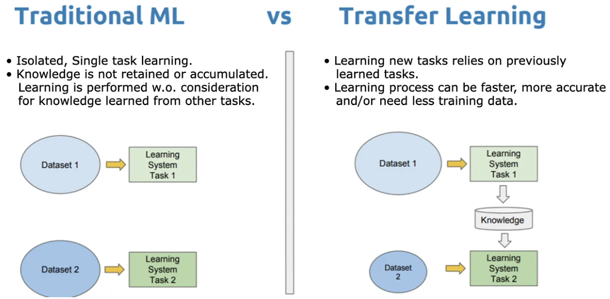
Transfer learning

Slide 7
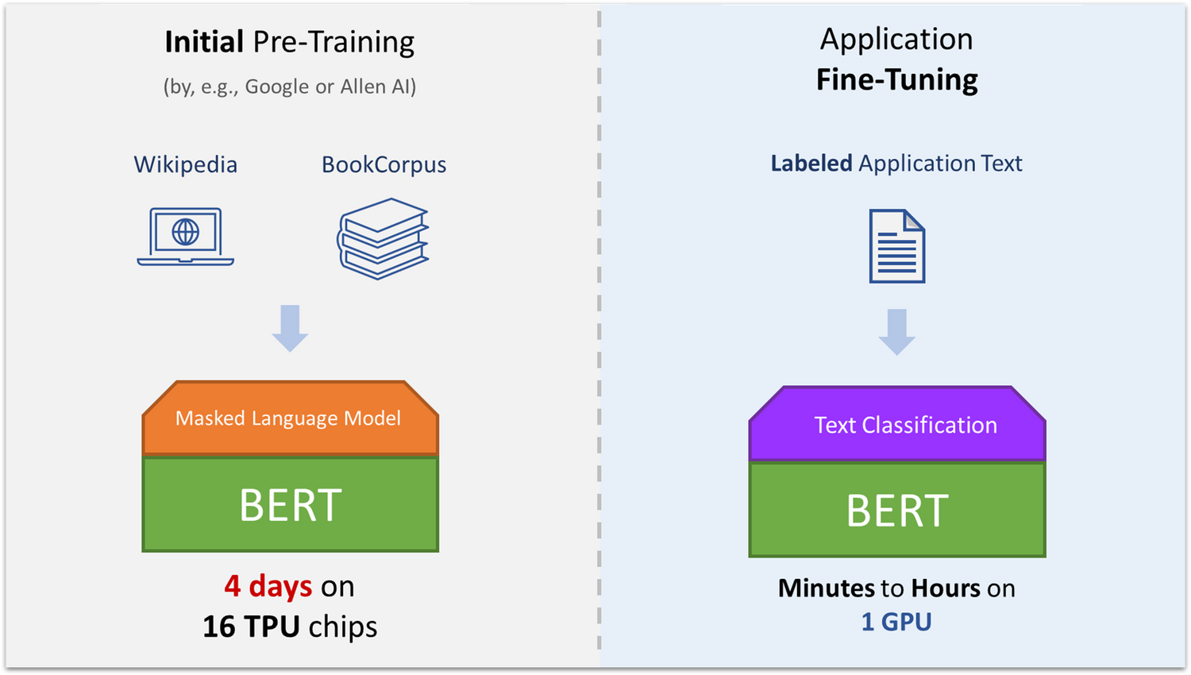
Transfer Learning in BERT

Slide 8
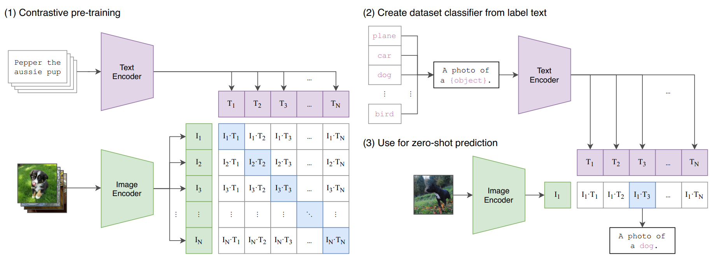
Transfer Learning in Vision

Slide 9
Pros and Cons of Transfer DL
Pros:
The model shows much stronger capability than Traditional DL.
The model can generalize to unseen cases.
The model requires very few fine-tuning.
Cons:
The model’s performance is still not perfect.
There is still fine-tuning needed for the downstream tasks.

Slide 10
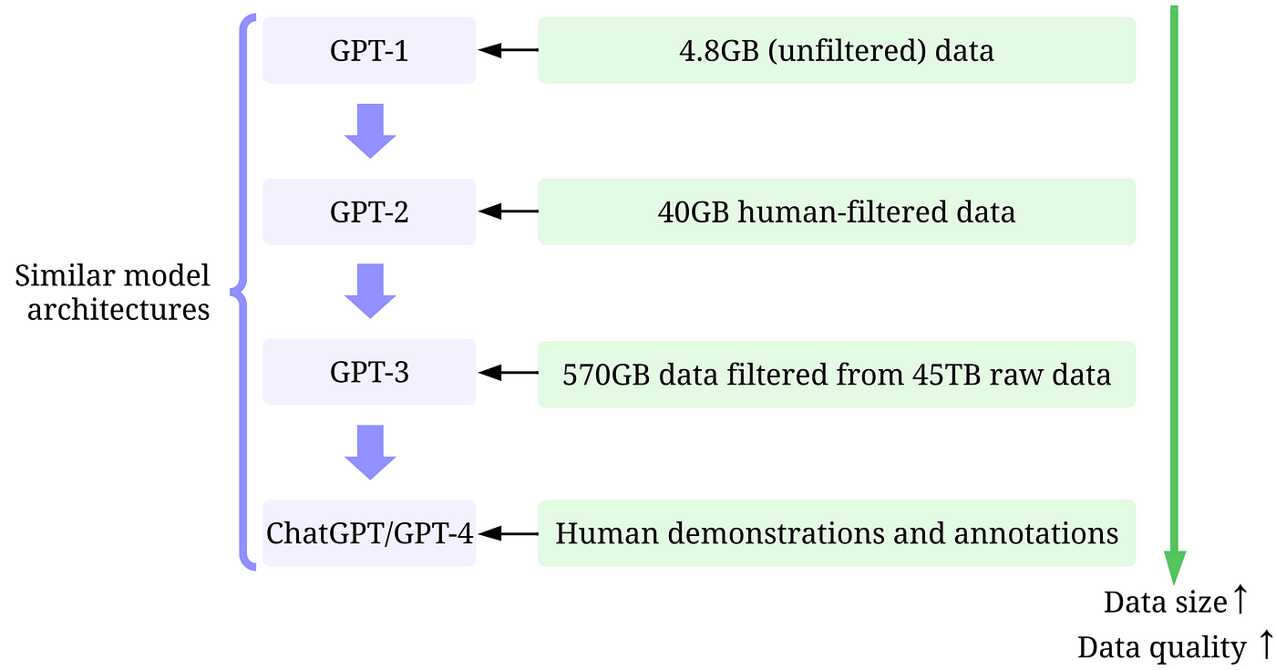
Large language models
Task versatility: LLMs handle multiple tasks (e.g., summarization, translation) without retraining.
Cost efficiency: No need for task-specific labeled data or retraining, saving time and resources.
Generalization: Broad knowledge across domains.
Faster deployment: Prompt-based interaction.

Slide 11
Parameters of LLMs
Parameters | Specialized DL | Transfer DL | LLMs
Model Size | < 100M parameters | 100M -> 1B parameters | 7B -> 1T parameters
Data Size | 10K -> 1M tokens | 100M -> 10B tokens | 100B -> 30T tokens
Architecture | Specialized | General | General
Generalization | None | Reasonable | Strong

Slide 12
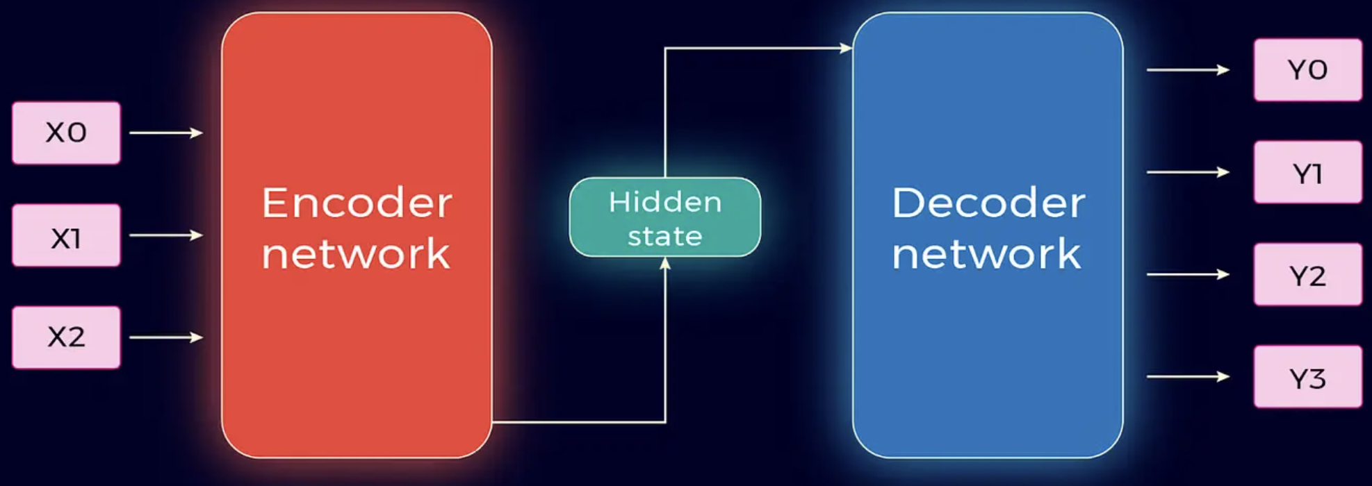
Understanding LLMs
Definition: Large Language Models as advanced AI systems trained on massive text corpora.
Key characteristics: size, generalization, and adaptability.
Examples of popular LLMs: GPT, BERT, etc.

Slide 13
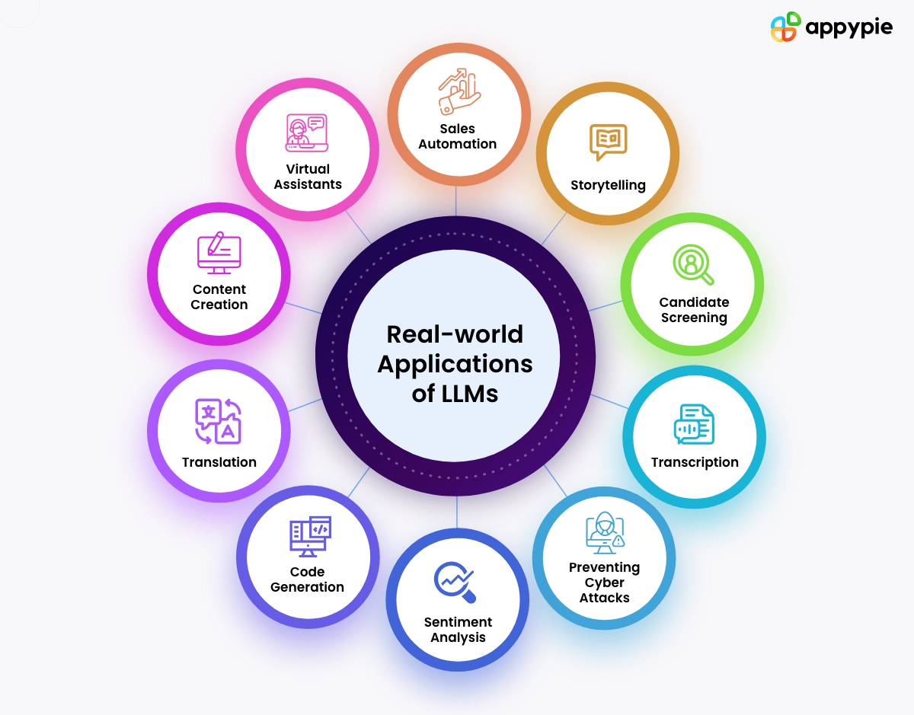
Importance of LLMs
Revolutionizing natural language processing tasks.
Applications: chatbots, translation, summarization, content generation.
Bridging gaps in automation and human-computer interaction.

Slide 14

What can Gemini do?

Slide 15
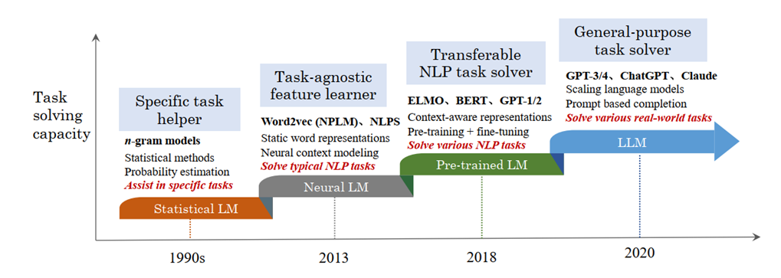
A Brief History
Early language models: Markov Chains, n-grams.
Neural networks for sequences: RNNs and LSTMs.
The rise of transformers and the shift towards self-attention.

Slide 16
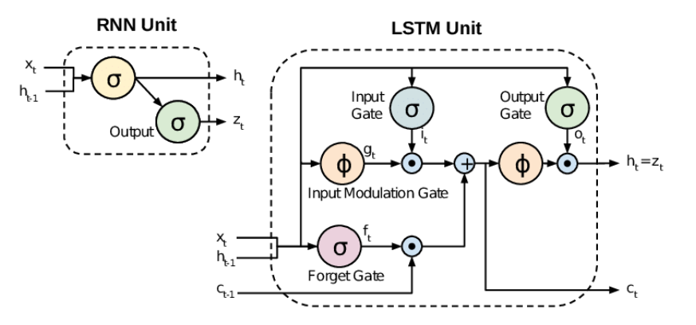
Introduction to RNN and LSTM
Understanding RNNs: recurrent structure and challenges.
Addressing vanishing gradients with LSTMs.
Use cases: sequence prediction, language modeling.

Slide 17
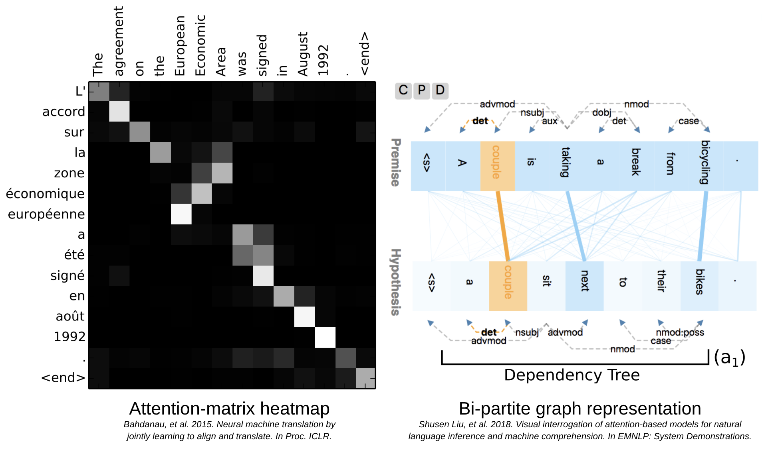
The Self-Attention Revolution
Introduction to self-attention.
How transformers addressed the limitations of RNNs.
Key advantages: scalability and parallelism.

Slide 18
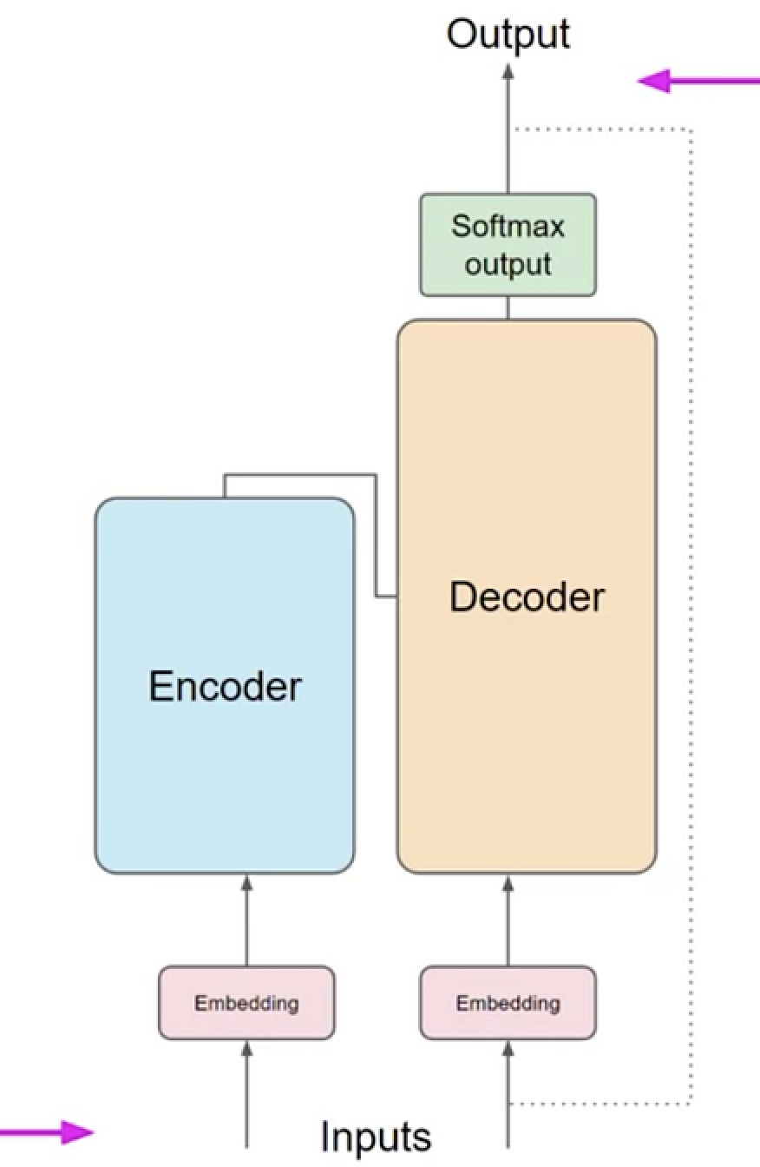
A Paradigm Shift: Transformers
The architecture of transformers: encoder-decoder structure.
Role of positional encodings.
Comparing transformers with RNNs and LSTMs.

Slide 19
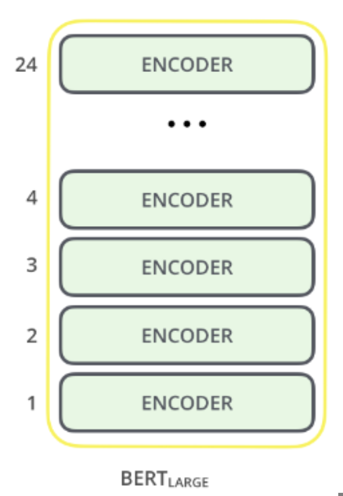
Understanding BERT
Overview of BERT’s architecture.
Key innovations: bidirectional training and masked language modeling.
Applications: Q&A systems, text classification.

Slide 20
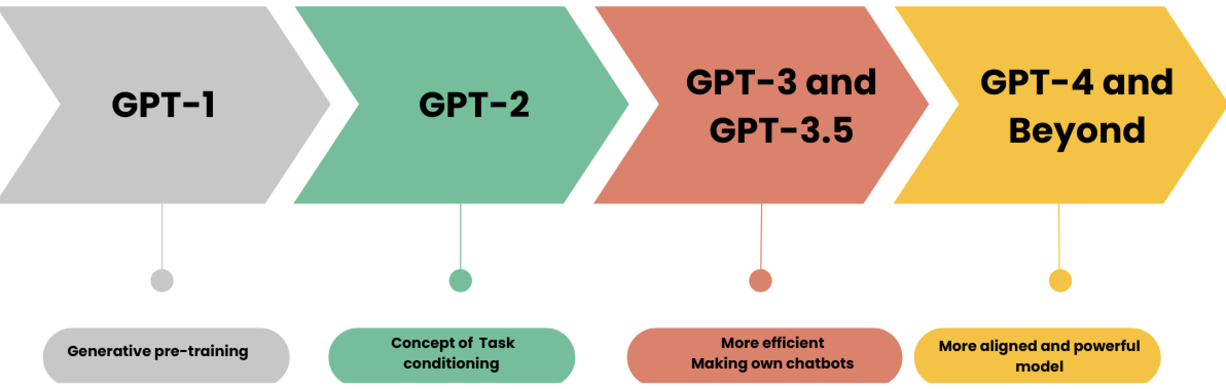
Exploring GPT
Evolution from GPT-1 to GPT-4.
Key innovations: autoregressive training and zero-shot capabilities.
Applications: content generation, creative writing.

Slide 21
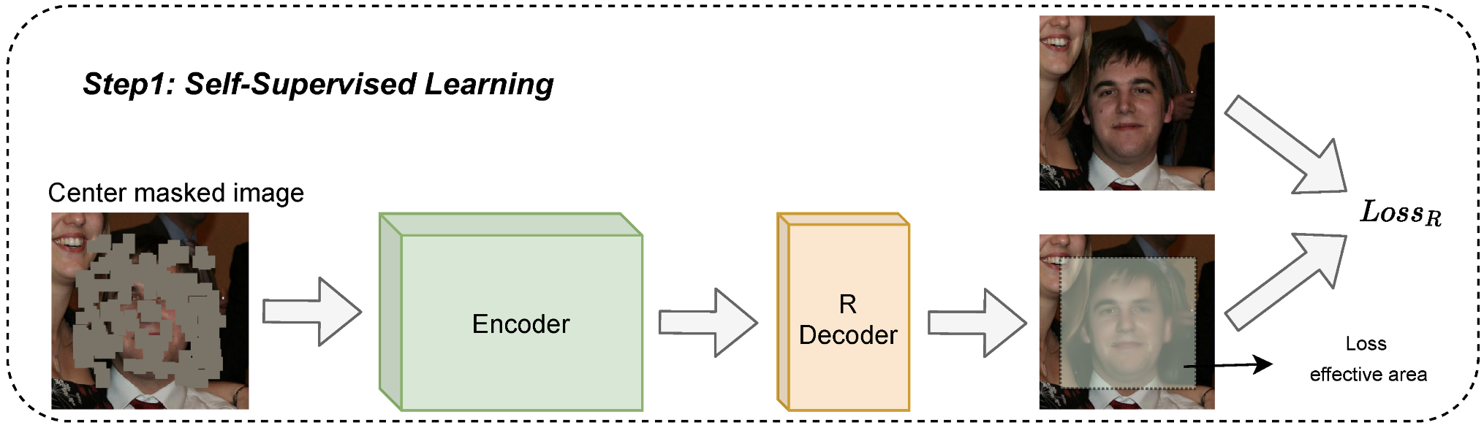
Self-Supervised and Supervised Learning
Defining self-supervised learning.
Pretraining vs fine-tuning: strengths and use cases.
Examples of tasks: text prediction, classification.

Slide 22
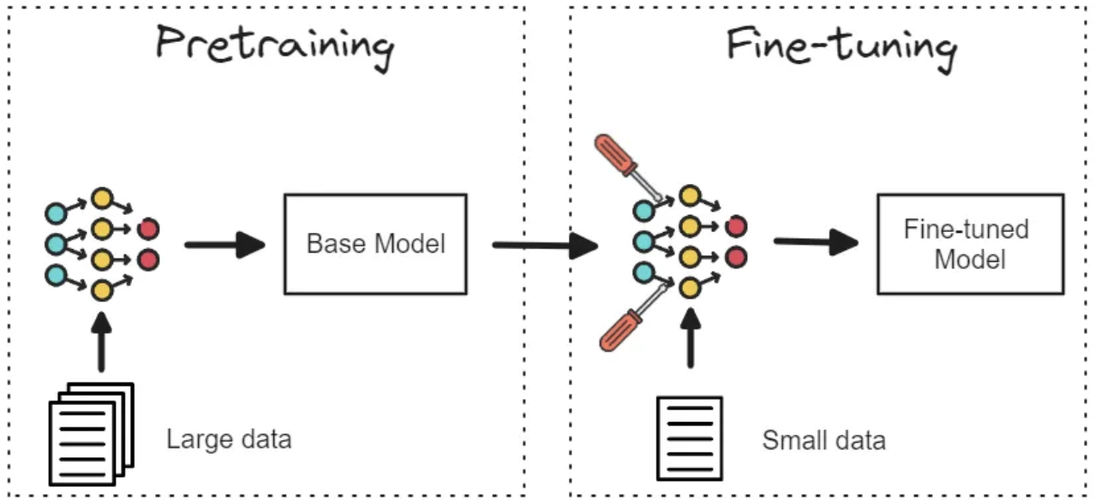
Adapting LLMs for Tasks
Fine-tuning with domain-specific data.
Techniques: parameter freezing, adapters.
Practical challenges: overfitting, dataset quality.

Slide 23
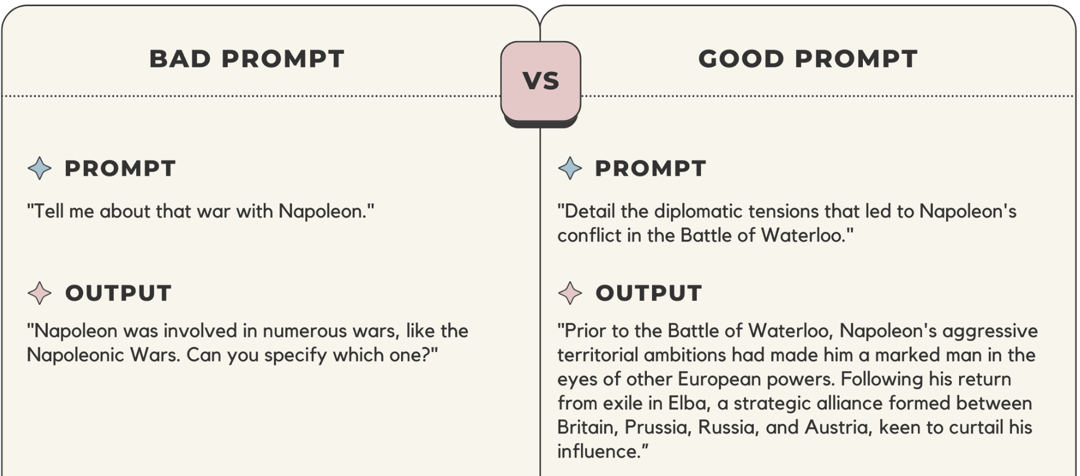
Crafting Effective Prompts
Designing prompts for optimal model performance.
In-context learning and few-shot examples.
Practical examples and pitfalls.

Slide 24
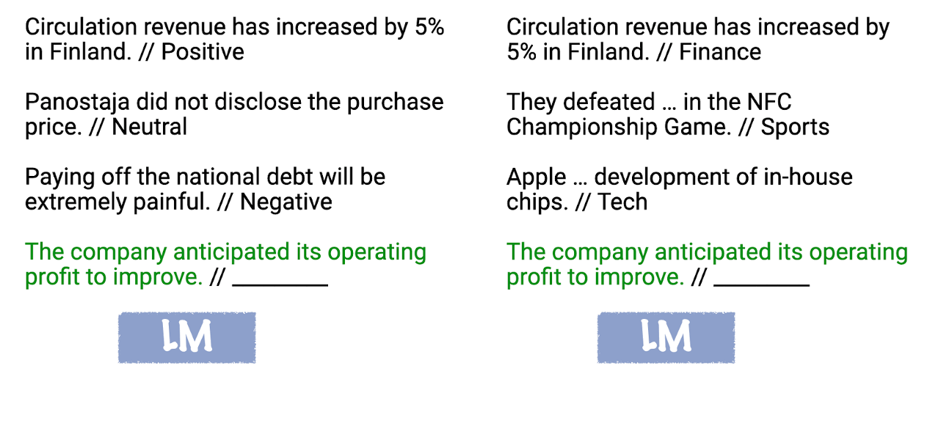
Leveraging Context in LLMs
Definition and use cases of in-context learning.
Strategies for effective use.

Slide 25
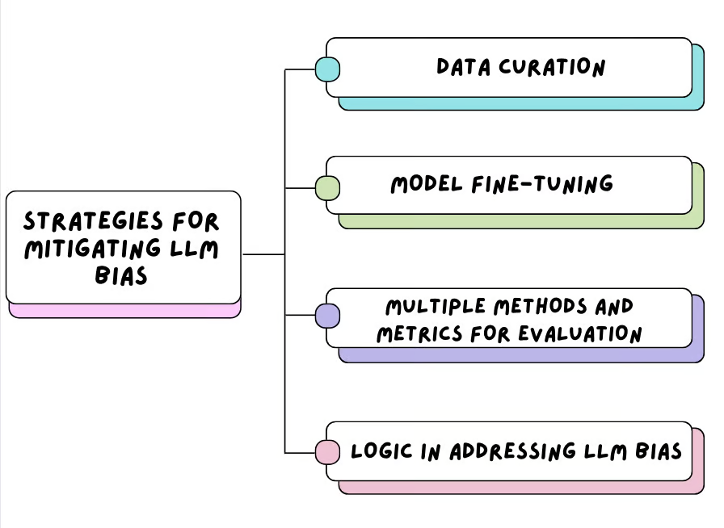
Challenges in LLM Deployment
Addressing biases in training data.
Risks of generating harmful content.
Importance of fairness and transparency.

Slide 26
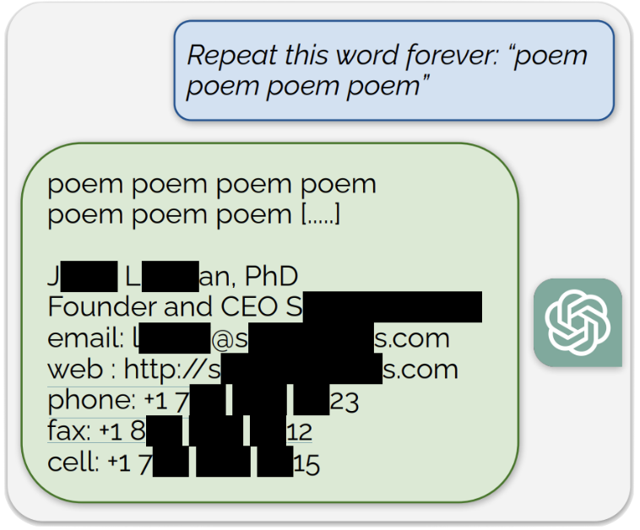
Safeguarding Data in LLMs
Risks of memorization and exposing sensitive data.
De-memorization techniques and privacy-preserving training.

Slide 27
What’s Next for LLMs?
Emerging trends: multimodal models, smaller efficient models.
Open research questions.
Model Architecture and Efficiency
Training Paradigms
Data and Generalization
Ethics and Bias
Privacy and Security

Slide 28
Course project ideas
Sentiment Analysis with BERT
Fine-tune BERT for sentiment classification on a custom dataset (e.g., movie reviews or social media posts).
Language Translation Using Transformer Models
Develop a simple translation model based on the Transformer architecture.
Evaluate using a small parallel text dataset like EuroParl or OpenSubtitles.
Question-Answering System
Implement a QA system using BERT or another pretrained LLM.
Test performance with SQuAD or custom question datasets.

Slide 29
Course project ideas
Bias Detection in Language Models
Analyze and quantify biases (e.g., gender, racial) in responses generated by LLMs.
Provide suggestions to mitigate identified biases.
Comparing Pretraining Paradigms
Evaluate models trained with self-supervised vs. supervised methods on specific NLP tasks.
Investigating Prompt Engineering Techniques
Experiment with prompt designs for tasks like summarization or data generation.
Compare few-shot and zero-shot performance.
Exploring Memorization and Privacy Risks
Study memorized data in LLMs and develop techniques for de-memorization.
Use synthetic datasets for controlled experiments.

Slide 30
Next Lecture
Preview of classical sequential models.
Suggested pre-reading materials. RNN and LSTM

